Slide 1
UNIT – 7 (Part 2)
Servlets and JSP

Slide 2
What is JSP?
JSP technology is used to create web application just like Servlet technology. It can be thought of as an extension to Servlet because it provides more functionality than servlet.
A JSP page consists of HTML tags and JSP tags. The JSP pages are easier to maintain than Servlet because we can separate designing and development.

Slide 3
Advantages of JSP over Servlet
Extension to Servlet: We can use all features of Servlets in JSP. Plus, we can use other additional features such as predefined tags, expression language etc.
Easy to Maintain: JSP can be easily managed because we can separate business logic with presentation logic. In Servlets, we mix both logics.
Fast Development: If JSP page is modified, we don't need to recompile and redeploy the project. The Servlet code needs to be updated and recompiled if we have to change the look and feel of the application.
Less code than Servlet: In JSP, we can use many tags such as action tags, JSTL, custom tags, etc. that reduces the code.

Slide 4
Example
<html>
<body>
<% out.print(2*5); %>
</body>
</html>
Follow the following steps to execute this JSP page:
Start the server
Put the JSP file in a folder and deploy on the server
Visit the browser by the URL http://localhost:portno/contextRoot/jspfile, for example, http://localhost:8888/myapplication/index.jsp
Output: 10

Slide 5
Print “Hello Class” 10 times in JSP.
<%
String hello = "Hello Class";
for (int i = 0; i < 10; i++) {
out.print("<P>" + hello + "</p>");
}
%>

Slide 6
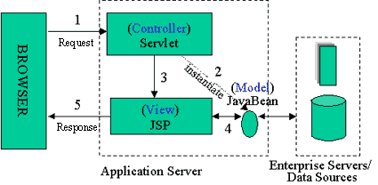
JSP Architecture

Slide 7
Browser sends an HTTP request to the web server.
The web server recognizes that the HTTP request is for a JSP page and forwards it to a JSP engine. This is done by using the URL or JSP page which ends with .jsp instead of .html
The JSP engine loads the JSP page from disk and converts it into a servlet content. This conversion is very simple in which all template text is converted to println( ) statements and all JSP elements are converted to Java code.
The JSP engine compiles the servlet into an executable class and forwards the original request to a servlet engine.
A part of the web server called the servlet engine loads the Servlet class and executes it. During execution, the servlet produces an output in HTML format. The output is further passed on to the web server by the servlet engine inside an HTTP response.
The web server forwards the HTTP response to your browser in terms of static HTML content.
Finally, the web browser handles the dynamically-generated HTML page inside the HTTP response exactly as if it were a static page.

Slide 8
Form Processing in JSP
JSP handles form data parsing automatically using the following methods depending on the situation −
getParameter() − You call request.getParameter() method to get the value of a form parameter.
getParameterValues() − Call this method if the parameter appears more than once and returns multiple values, for example checkbox.
getParameterNames() − Call this method if you want a complete list of all parameters in the current request.
getInputStream() − Call this method to read binary data stream coming from the client.

Slide 9
GET/POST Method Example Using URL
<html>
<head>
<title>Using GET Method to Read Form Data</title>
</head>
<body>
<h1>Using GET Method to Read Form Data</h1>
<ul>
<li><p><b>First Name:</b>
<%= request.getParameter("first_name")%>
</p></li>
<li><p><b>Last Name:</b>
<%= request.getParameter("last_name")%>
</p></li>
</ul>
</body>
</html>
http://localhost:8080/main.jsp?first_name=Corona&last_name=Virus

Slide 10
Exception Handling in JSP
index.jsp
<form action="process.jsp">
No1:<input type="text" name="n1" /><br/><br/>
No1:<input type="text" name="n2" /><br/><br/>
<input type="submit" value="divide"/>
</form>
process.jsp
<%@ page errorPage="error.jsp" %>
<%
String num1=request.getParameter("n1");
String num2=request.getParameter("n2");
int a=Integer.parseInt(num1);
int b=Integer.parseInt(num2);
int c=a/b;
out.print("division of numbers is: "+c);
%>
error.jsp
<%@ page isErrorPage="true" %>
<h3>Sorry an exception occured!</h3>
Exception is: <%= exception %>

Slide 11
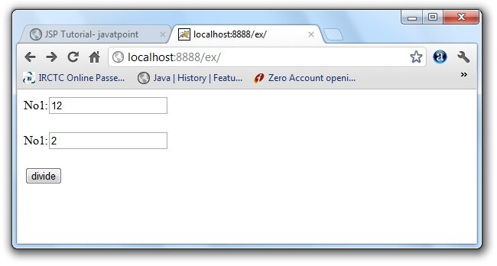
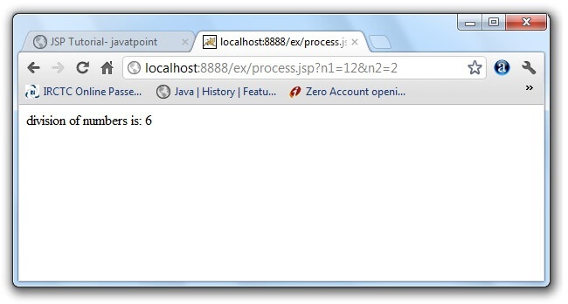
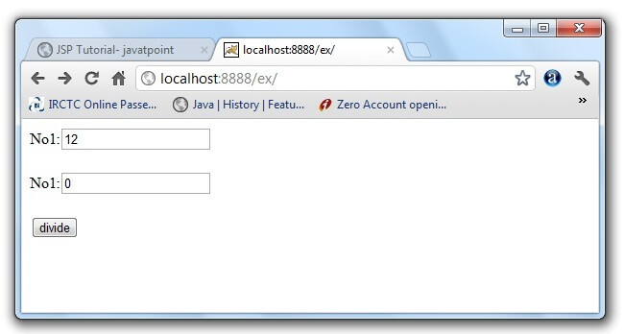
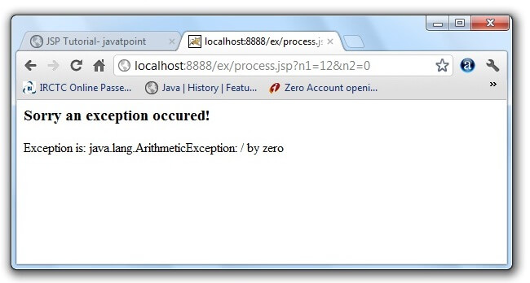

Slide 12
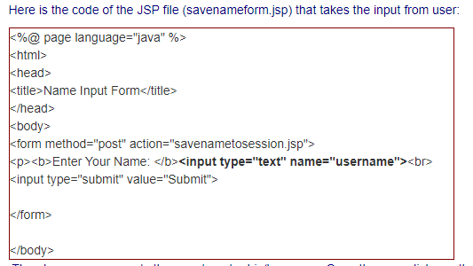
Working with sessions ( how to track the session between different JSP pages)
The above page prompts the user to enter his/her name. Once the user clicks on the submit button, savenametosession.jsp is called. The JSP savenametosession.jsp retrieves the user name from request attributes and saves into the user session using the function session.setAttribute("username",username);.

Slide 13
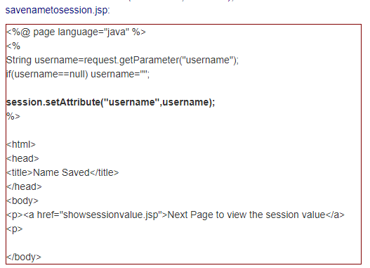
The above JSP saves the user name into the session object and displays a link to next pages (showsessionvalue.jsp). When user clicks on the "Next Page to view session value" link, the JSP page showsessionvalue.jsp displays the user name to the user.

Slide 14
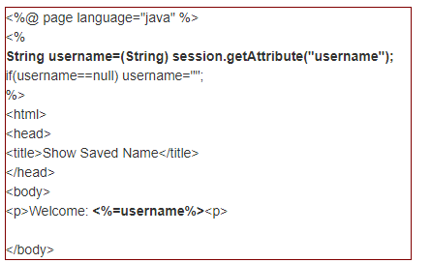
showsessionvalue.jsp
The function
session.getAttribute("username")
is used to retrieve the user name saved in the session.

Slide 15

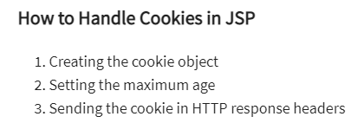
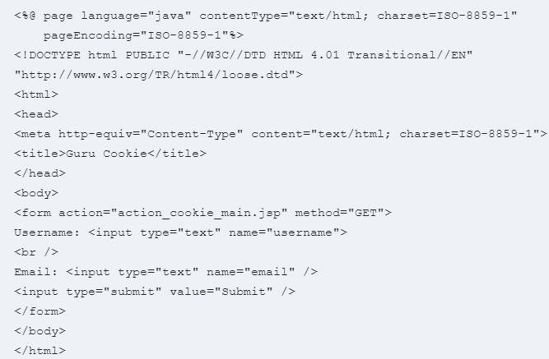
Cookies are the text files which are stored on the client machine.
They are used to track the information for various purposes.
It supports HTTP cookies using servlet technology
The cookies are set in the HTTP Header.
If the browser is configured to store cookies, it will keep information until expiry date.
Example:
In this JSP cookies example, we will learn how to call cookie constructor in JSP by creating cookies of username and email, and add age to the cookie for 10 hours and trying to get the variable names in the action_cookie.jsp

Slide 16
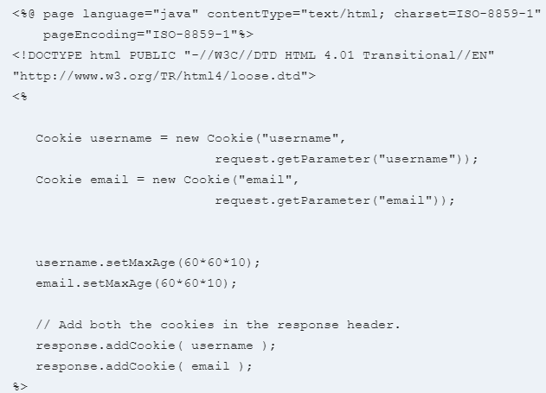
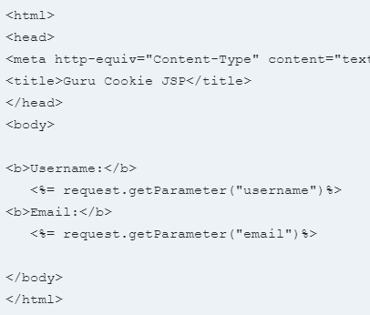
Action_cookie_main.jsp

Slide 17
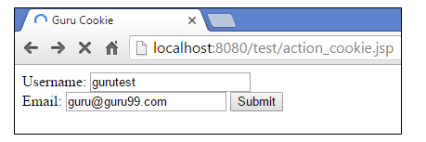
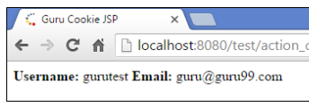
Output:

Slide 18
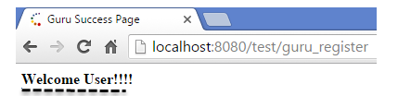
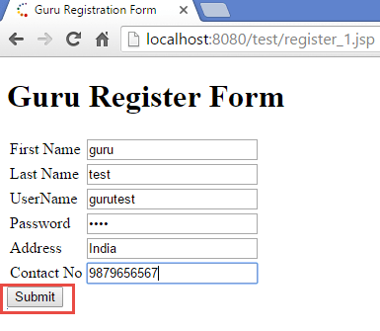
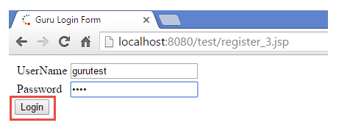
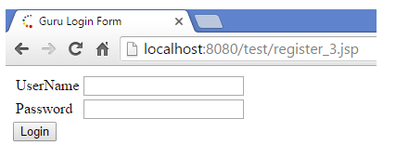
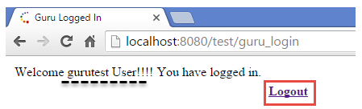
Registration & Login Form

Slide 19

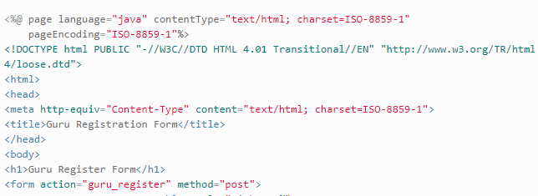
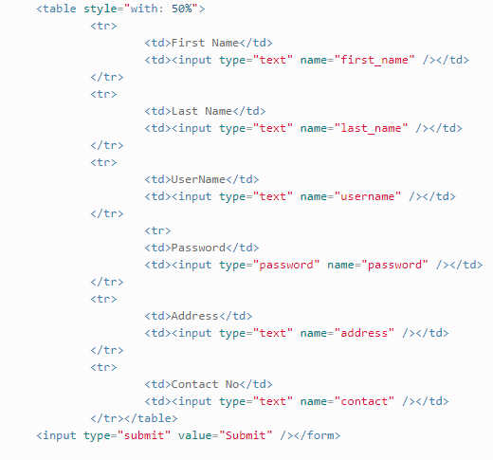

On click of this button the action will go to corresponding guru_register servlet where all the parameter values will be passed in the request.

Slide 20

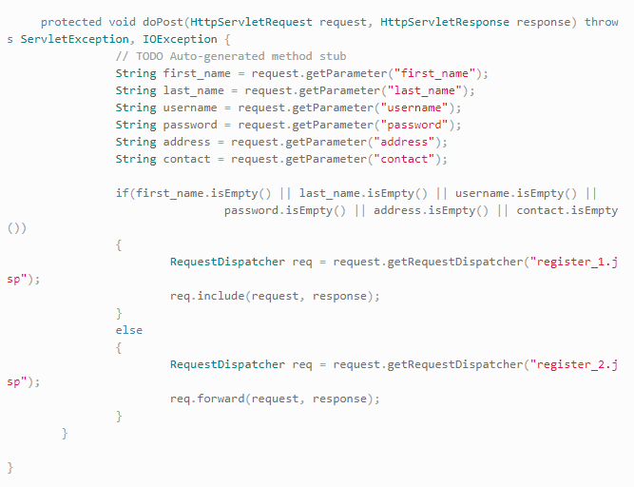
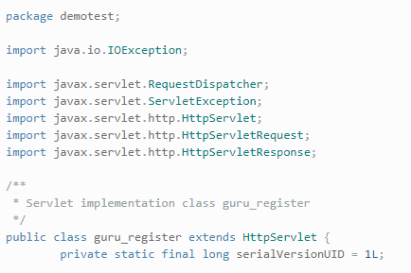
If any of the parameter is empty then it will enter this condition ( first_name.isEmpty() || last_name.isEmpty || username.isEmpty || password.isEmpty || address.isEmpty || contact.isEmpty()) and we have to fetch RequestDispatcher object using request object which will forward request to register_1.jsp. Here we are also including request and response objects.

Slide 21

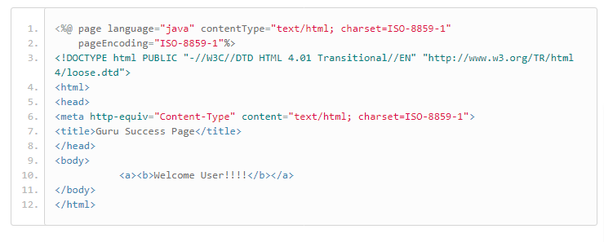

Slide 22
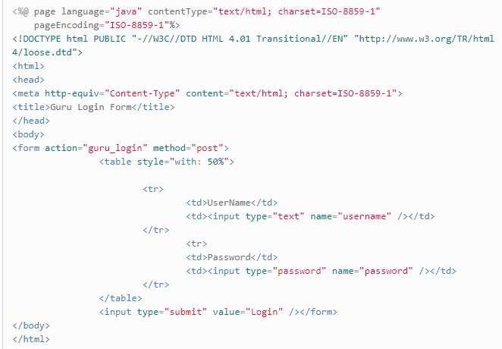


Slide 23

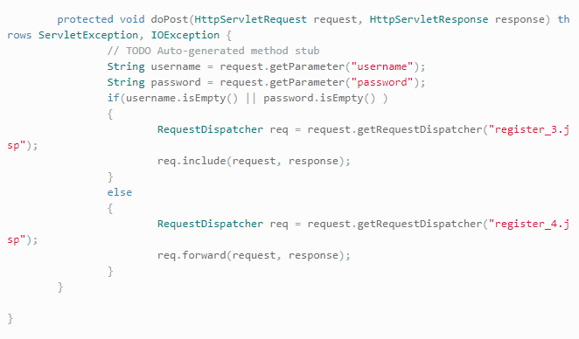
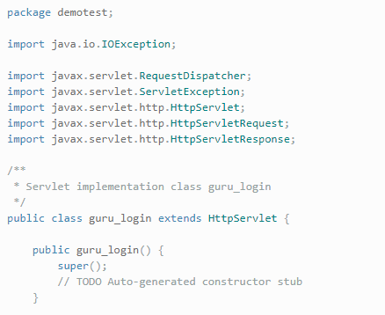

Slide 24

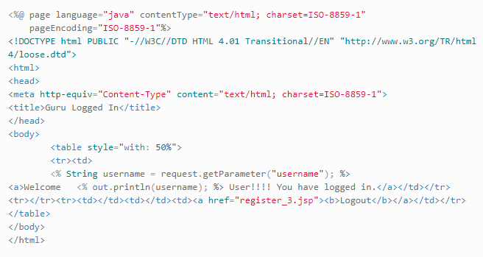

Slide 25
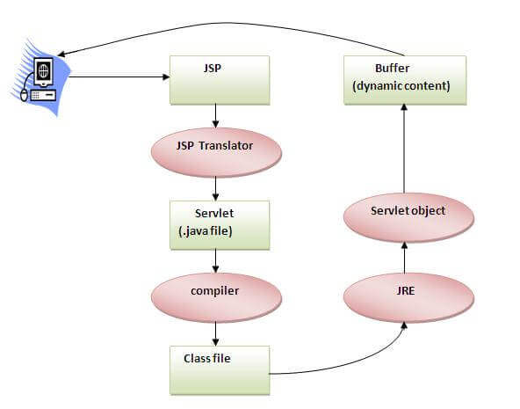
The Lifecycle of a JSP Page
The JSP pages follow these phases:
Translation of JSP Page
Compilation of JSP Page
Class loading (the classloader loads class file)
Instantiation (Object of the Generated Servlet is created).
Initialization ( the container invokes jspInit() method).
Request processing ( the container invokes _jspService() method).
Destroy ( the container invokes jspDestroy() method).

Slide 26
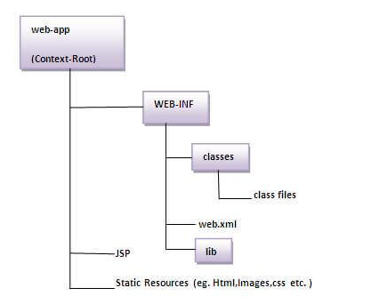
The Directory structure of JSP

Slide 27
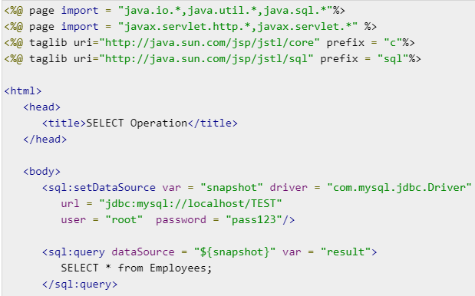
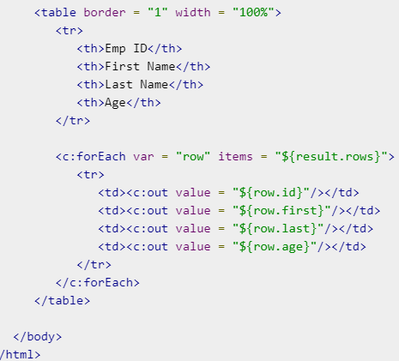
JSP - Database Access
SELECT Operation

Slide 28
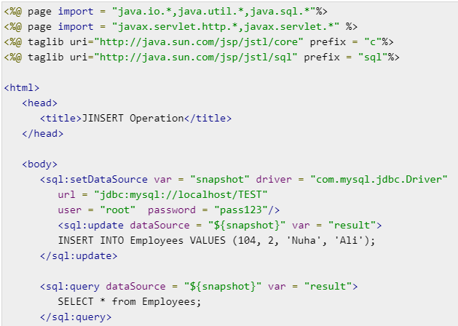
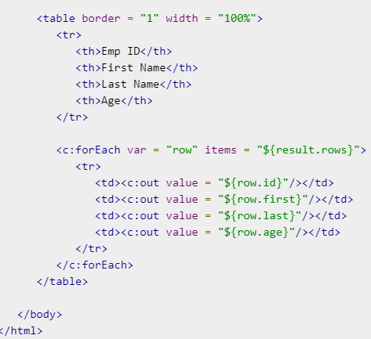
INSERT Operation

Slide 29
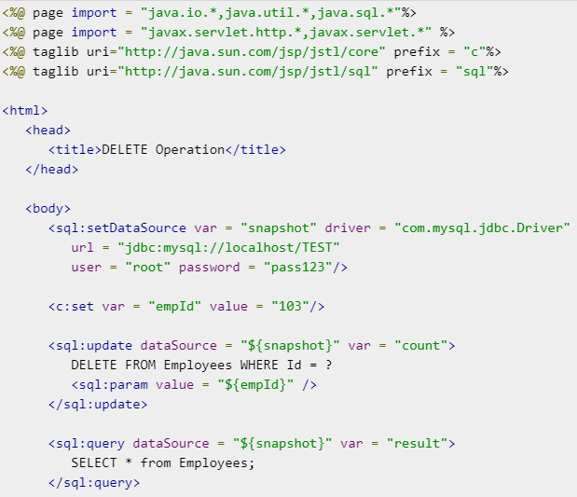
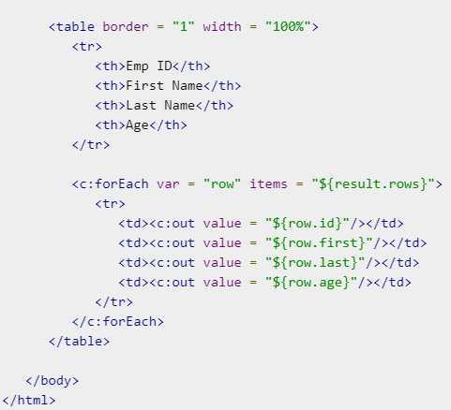
DELETE Operation

Slide 30
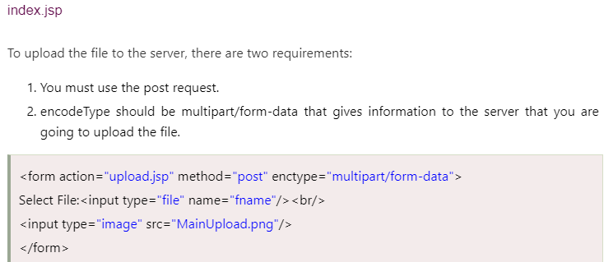
Uploading file to the server using JSP
There are many ways to upload the file to the server. One of the way is by the MultipartRequest class. For using this class you need to have the cos.jar file.
upload.jsp
<%@ page import="com.oreilly.servlet.MultipartRequest" %>
<%
MultipartRequest m = new MultipartRequest(request, "d:/new");
out.print("successfully uploaded");
%>

Slide 31
1. Which page directive should be used in JSP to generate a PDF page? a) contentType b) generatePdf c) typePDF d) contentPDF
2. “request” is instance of which one of the following classes? a) Request b) HttpRequest c) HttpServletRequest d) ServletRequest
3. Which is not a directive? a) include b) page c) export d) useBean

Slide 32
Old Questions [TU]
What is JSP? Differentiate it with servelet. (2+3) [2069]
Write a simple JSP program to display “Lalitpur, Nepal” 10 times. (5)[2070]
Write a simple JSP program to display “Tribhuwan University” 10 times. (5) [2071]
Compare and contrast between Servlets and Java Server pages? How web server responds to servlets and JSP page? Write down sample example. Handling HTTP Request and Response using servlets. [Model Question]

Slide 33
Video Links
https://www.youtube.com/watch?v=7oKFVlaVIck [Run JSP Step by Step]
https://www.youtube.com/watch?v=_oEOH23OYYQ [JSP Registration Form with Database]
https://www.youtube.com/watch?v=04zDrzyhe9o [JSP Session Management]
https://www.youtube.com/watch?v=4Sl9R9K0uoE [JSP Exception Handling]

